Slide 1
Servlets
Servlet technology is used to create a web application (resides at server side and generates a dynamic web page).
Servlets are the Java programs that run on the Java-enabled web server or application server. They are used to handle the request obtained from the webserver, process the request, produce the response, then send a response back to the webserver.
Servlet technology is robust and scalable because of java language.
Before Servlet, CGI (Common Gateway Interface) scripting language was common as a server-side programming language. However, there were many disadvantages to this technology.

Slide 2
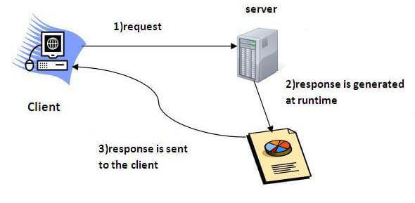
What is a Servlet?
Servlet is a technology which is used to create a web application.
Servlet is an API that provides many interfaces and classes including documentation.
Servlet is an interface that must be implemented for creating any Servlet.
Servlet is a class that extends the capabilities of the servers and responds to the incoming requests. It can respond to any requests.
Servlet is a web component that is deployed on the server to create a dynamic web page.

Slide 3
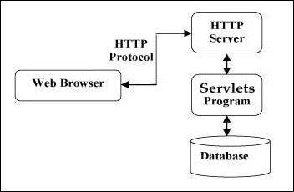
Servlets basically involves six basic steps:
The clients send the request to the webserver.
The web server receives the request.
The web server passes the request to the corresponding servlet.
The servlet processes the request and generates the response in the form of output.
The servlet sends the response back to the webserver.
The web server sends the response back to the client and the client browser displays it on the screen.

Slide 4
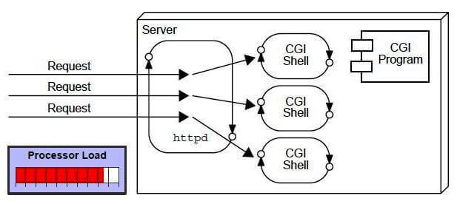
What is a web application?
A web application is an application accessible from the web. A web application is composed of web components like Servlet, JSP, Filter, etc. and other elements such as HTML, CSS, and JavaScript. The web components typically execute in Web Server and respond to the HTTP request.
CGI (Common Gateway Interface) :
CGI technology enables the web server to call an external program and pass HTTP request information to the external program to process the request. For each request, it starts a new process.

Slide 5
Disadvantages of CGI (Common Gateway Interface) :
There are many problems in CGI technology:
If the number of clients increases, it takes more time for sending the response.
For each request, it starts a process, and the web server is limited to start processes.
It uses platform dependent language e.g. C , C++ , perl
Advantages of Servlet :
There are many advantages of Servlet over CGI. The web container creates threads for handling the multiple requests to the Servlet. Threads have many benefits over the Processes such as they share a common memory area, lightweight, cost of communication between the threads are low.
Better performance: because it creates a thread for each request, not process.
Portability: because it uses Java language.
Robust: JVM manages Servlets, so we don't need to worry about the memory leak, garbage collection, etc.
Secure: because it uses java language.

Slide 6
Website :
Website is a collection of related web pages that may contain text, images, audio and video. The first page of a website is called home page. Each website has specific internet address (URL) that you need to enter in your browser to access a website.
Website is hosted on one or more servers and can be accessed by visiting its homepage using a computer network. A website is managed by its owner that can be an individual, company or an organization.
A website can be of two types:
Static Website
Dynamic Website
Static website
The codes are fixed for each page so the information contained in the page does not change and it looks like a printed page.
Dynamic website
Dynamic website is a collection of dynamic web pages whose content changes dynamically. It accesses content from a database or Content Management System (CMS). Therefore, when you alter or update the content of the database, the content of the website is also altered or updated.

Slide 7
HTTP (Hyper Text Transfer Protocol) :
The Hypertext Transfer Protocol (HTTP) is application-level protocol for collaborative, distributed, hypermedia information systems. It is the data communication protocol used to establish communication between client and server.
HTTP Requests
It is the request send by the computer to a web server that contains all sorts of potentially interesting information.

Slide 8
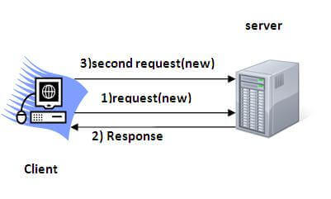
Session Tracking in Servlets :
Session simply means a particular interval of time.
Session Tracking is a way to maintain state (data) of an user. It is also known as session management in servlet.
Http protocol is a stateless so we need to maintain state using session tracking techniques. Each time user requests to the server, server treats the request as the new request. So we need to maintain the state of an user to recognize to particular user.

Slide 9
Session Tracking Techniques :
There are four techniques used in Session tracking:
Cookies
Hidden Form Field
URL Rewriting
HttpSession

Slide 10
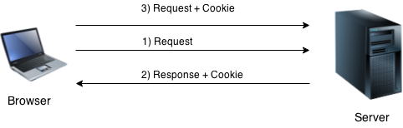
Cookies in Servlet :
A cookie is a small piece of information that is persisted between the multiple client requests.
A cookie has a name, a single value, and optional attributes such as a comment, path and domain qualifiers, a maximum age, and a version number.
How Cookie works
In cookies technique, we add cookie with response from the servlet. So cookie is stored in the cache of the browser. After that if request is sent by the user, cookie is added with request by default. Thus, we recognize the user as the old user.

Slide 11
Types of Cookie
There are 2 types of cookies in servlets.
Non-persistent cookie
Persistent cookie
Non-persistent cookie
It is valid for single session only. It is removed each time when user closes the browser.
Persistent cookie
It is valid for multiple session . It is not removed each time when user closes the browser. It is removed only if user logout or signout.

Slide 12
Types of Cookie
There are 2 types of cookies in servlets.
Non-persistent cookie
Persistent cookie
Non-persistent cookie
It is valid for single session only. It is removed each time when user closes the browser.
Persistent cookie
It is valid for multiple session . It is not removed each time when user closes the browser. It is removed only if user logout or signout.

Slide 13
Advantage of Cookies :
Simplest technique of maintaining the state.
Cookies are maintained at client side.
Disadvantage of Cookies :
It will not work if cookie is disabled from the browser.
Only textual information can be set in Cookie object.

Slide 14
Cookie class
javax.servlet.http.Cookie class provides the functionality of using cookies. It provides a lot of useful methods for cookies.
Constructor | Description
Cookie() | constructs a cookie.
Cookie(String name, String value) | constructs a cookie with a specified name and value.
Useful Methods of Cookie class :
Method | Description
public void setMaxAge(int expiry) | Sets the maximum age of the cookie in seconds.
public String getName() | Returns the name of the cookie. The name cannot be changed after creation.
public String getValue() | Returns the value of the cookie.
public void setName(String name) | changes the name of the cookie.
public void setValue(String value) | changes the value of the cookie.

Slide 15
Hidden Form Field :
A hidden (invisible) textfield is used for maintaining the state of an user.
we store the information in the hidden field and get it from another servlet. This approach is better if we have to submit form in all the pages and we don't want to depend on the browser.
Syntax :
<input type="hidden" name="uname" value=“Pranali Patil">
Advantage of Hidden Form Field :
It will always work whether cookie is disabled or not.
Disadvantage of Hidden Form Field:
It is maintained at server side.
Extra form submission is required on each pages.
Only textual information can be used.

Slide 16
URL Rewriting :
In URL rewriting, we append a token or identifier to the URL of the next Servlet or the next resource. We can send parameter name/value pairs using the following format:
url?name1=value1&name2=value2&??
Advantage of URL Rewriting:
It will always work whether cookie is disabled or not (browser independent).
Extra form submission is not required on each pages.
Disadvantage of URL Rewriting :
It will work only with links.
It can send Only textual information.

Slide 17
HttpSession interface :
In such case, container creates a session id for each user.The container uses this id to identify the particular user.
The HttpServletRequest interface provides two methods to get the object of HttpSession:
public HttpSession getSession():Returns the current session associated with this request, or if the request does not have a session, creates one.
public HttpSession getSession(boolean create):Returns the current HttpSession associated with this request or, if there is no current session and create is true, returns a new session.

Slide 18
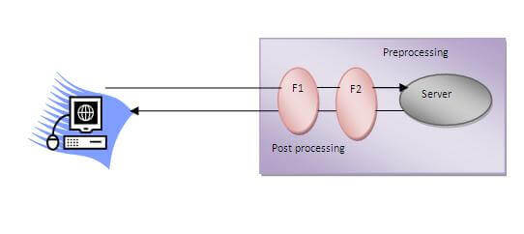
Servlet Filter :
A filter is an object that is invoked at the preprocessing and postprocessing of a request.
The servlet filter is pluggable, i.e. its entry is defined in the web.xml file, if we remove the entry of filter from the web.xml file, filter will be removed automatically and we don't need to change the servlet.

Slide 19
Usage of Filter
recording all incoming requests
logs the IP addresses of the computers from which the requests originate
conversion
data compression
encryption and decryption
input validation etc.
Advantage of Filter
Filter is pluggable.
One filter don't have dependency onto another resource.
Less Maintenance

Slide 20
ServletConfig Interface:
An object of ServletConfig is created by the web container for each servlet. This object can be used to get configuration information from web.xml file.
If the configuration information is modified from the web.xml file, we don't need to change the servlet. So it is easier to manage the web application if any specific content is modified from time to time.
Advantage of ServletConfig
The core advantage of ServletConfig is that you don't need to edit the servlet file if information is modified from the web.xml file.
Methods of ServletConfig interface
public String getInitParameter(String name):Returns the parameter value for the specified parameter name.
public Enumeration getInitParameterNames():Returns an enumeration of all the initialization parameter names.
public String getServletName():Returns the name of the servlet.
public ServletContext getServletContext():Returns an object of ServletContext.

Slide 21
ServletContext Interface :
An object of ServletContext is created by the web container at time of deploying the project. This object can be used to get configuration information from web.xml file. There is only one ServletContext object per web application.
If any information is shared to many servlet, it is better to provide it from the web.xml file using the
<context-param> element.
Advantage of ServletContext
Easy to maintain if any information is shared to all the servlet, it is better to make it available for all the servlet. We provide this information from the web.xml file, so if the information is changed, we don't need to modify the servlet. Thus it removes maintenance problem.

Slide 22
Servlet with Annotation :
Annotation represents the metadata. If you use annotation, deployment descriptor (web.xml file) is not required. But you should have tomcat7 as it will not run in the previous versions of tomcat. @WebServlet annotation is used to map the servlet with the specified name.
Syntax :
@WebServlet("/test")

Slide 23
CRUD in Servlet :
A CRUD (Create, Read, Update and Delete) application is the most important application for any project development. In Servlet, we can easily create CRUD application.

